Slide 1
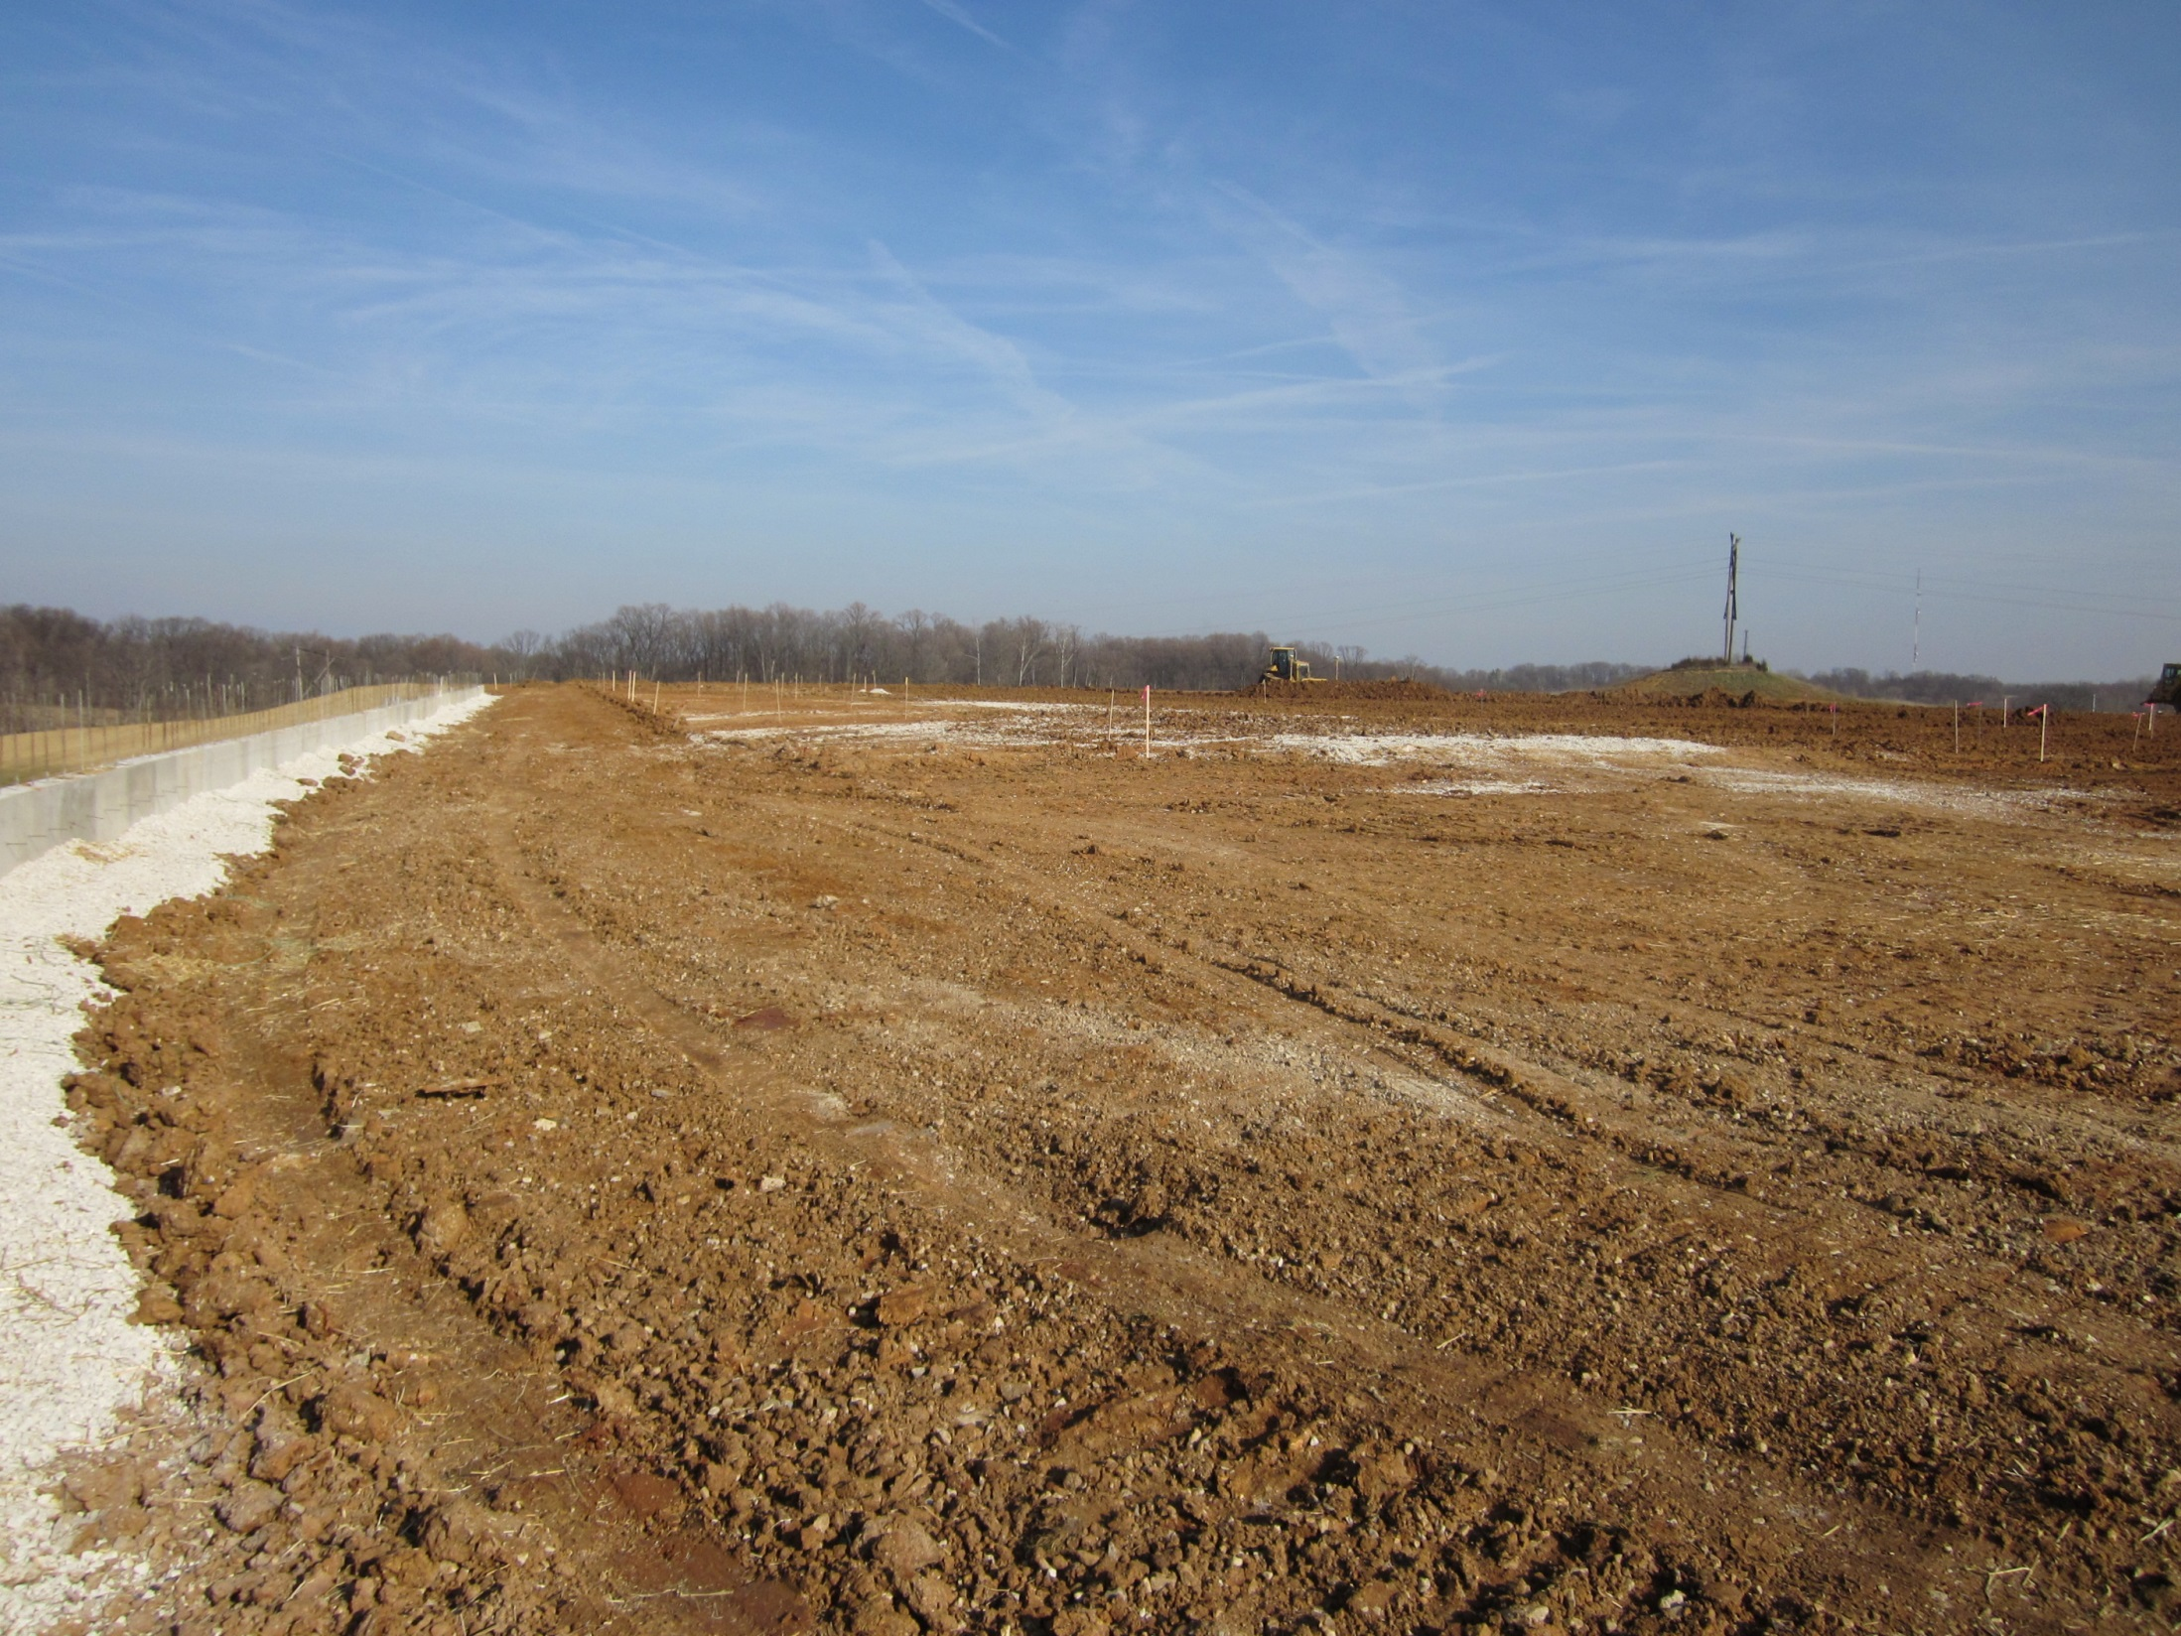
A Review of Erosion and Sediment Control Training Programs
Debra Ashack, Daniel Matson, Dana Wilkinson

Slide 2
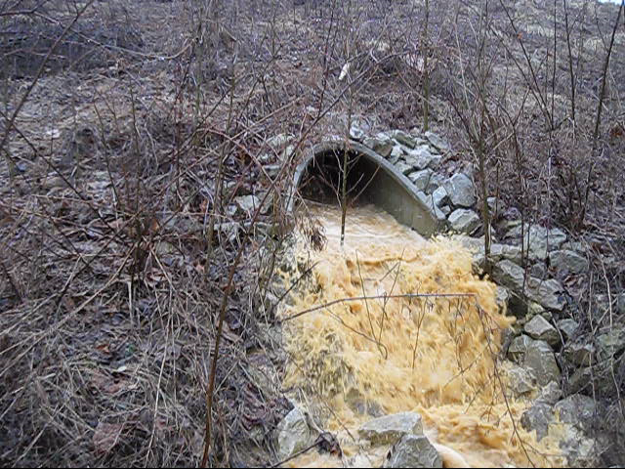

Slide 3
Overview
Importance
Planning a Workshop: Considerations & Implementation
Current Programs
Future Possibilities

Slide 4
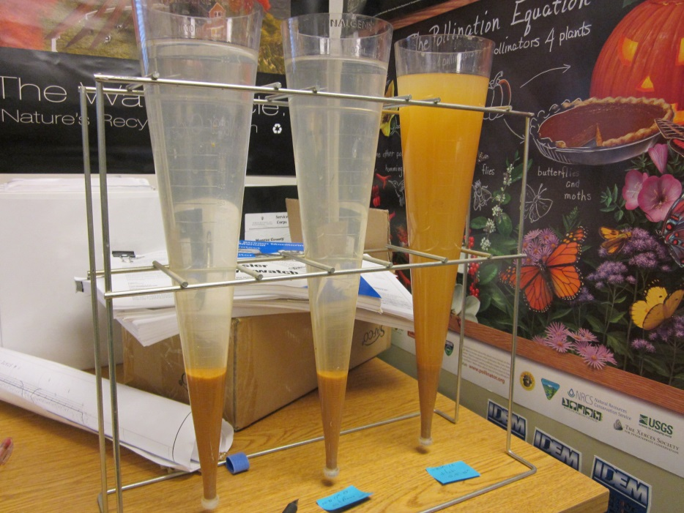
Why Does This Matter?
Sediment is the #1 Pollutant
  20-200 ton/acre/year
Clean Water Act Requirements
Costs
Feasibility

Slide 5
Planning a Workshop
Think about your goals & target audience
  Same topic needs to be tailored to suit different audiences;
  Who is your audience and what is their role in implementation?
  General session or specific training?
Length, Location, Logistics
  Dependent on target audience and their
    specific work environment
Possible Partnerships
Educational Materials
Refreshments!*
*(note: people like food)

Slide 6
Agenda
The “Why” question
  IDEM, MS4 representatives, Clean Water Act, Rule 5 & 13, local ordinances
Best Management Practices
Share updates or new products
Outside demonstrations
Breaks
Q & A

Slide 7
Review of Current Programs
Southern Indiana Stormwater Advisory Committee (SWAC): Qualified Professional Inspector (QPI)Program
7 MS4 community members, MOUs with local SWCDs
Bi-annual Training and at special request
Half-day classroom training
Certification exam following training
Certification required by most MS4 communities
Input from attendees, results of exam to adjust training
Key: consistency of message, unified MS4 communities

Slide 8
QPI Training Course
One-day training course held semiannually in the spring and fall
Qualifying exam with 98% pass rate
Registration with MS4
Free for municipal employees

Slide 9
Benefits for Municipal Employees
Better understanding of BMPs
Knowledge of Rule 5 & 13 process
More aware of the Stormwater Coordinator’s authority
Can contribute informal inspections while performing other tasks like property maintenance enforcement.
Detection of other unpermitted activities such as spills, illegal dumping, and other illicit discharges

Slide 10
Future Suggestions
Guidance Document
Survey of attendees
Statistics on # of violations on sites before & after training
Larger survey panel of those who provide workshops and training opportunities

